Slide 1
The
Elements and Principles of Art
Including Media and Processes

Slide 2
In order to understand and appreciate art, you must understand it’s language
So, if Art is a language, what is its grammar or structure?
We’ll find the answer in the
Elements and Principles of Design

Slide 3
The Elements and Principles of Design
The Elements of Design are:
Line, Shape, Form, Space, Value,Texture and Color
These are considered to be the “grammar” of art
The Principles of Design are:
Unity, Variety, Balance, Contrast, Emphasis, Pattern, Proportion, Movement and Rhythm
These are like the “rules of grammar”; they form the guidelines that artists follow when they combine the various elements of design
As you study visual art, and the world around you, you will notice that these Elements and Principles never appear by themselves.

Slide 4
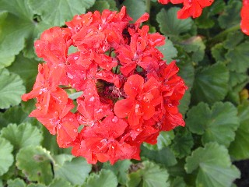
Let’s practice looking!
What elements do you see used in this geranium?

Slide 5
If you said:
Color (red and green)
Shape (the outlines of flowers and leaves)
Line (the stems, the veins of the leaves) and
Texture (smooth petals and furry leaves)
You were
CORRECT!

Slide 6
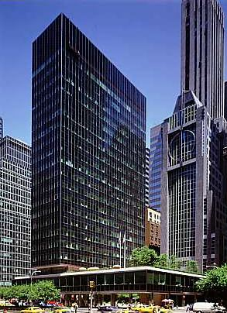
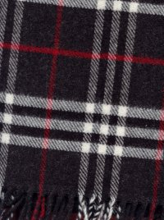
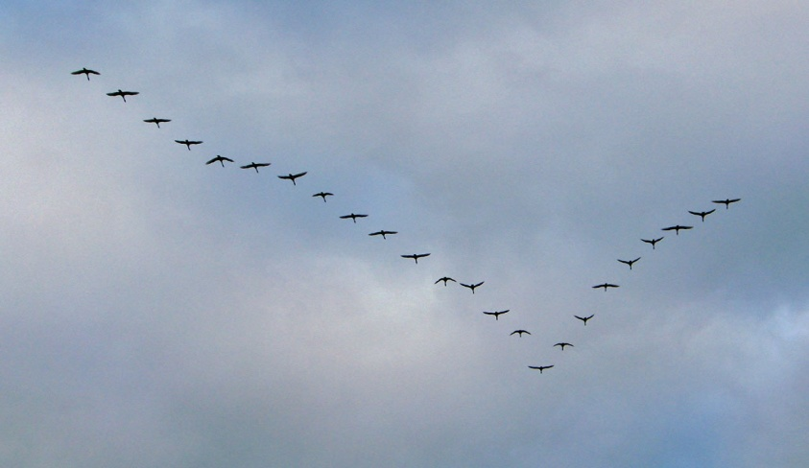
What principle(s) do you see used in these pictures?
A glass skyscraper
A plaid scarf
A flying bird

Slide 7

If you said:
Unity, Pattern, Proportion
Movement, Rhythm
Then you were CORRECT!
Pattern, Unity, Contrast

Slide 8
Now we will be learning
the definitions for
our new "grammar"
and looking at examples for each

Slide 9
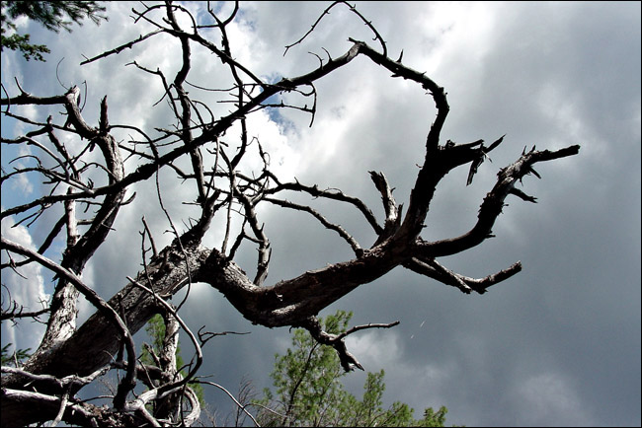
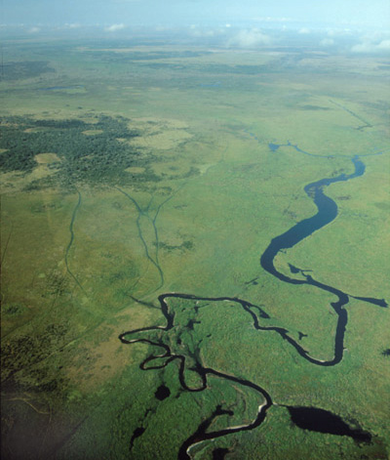
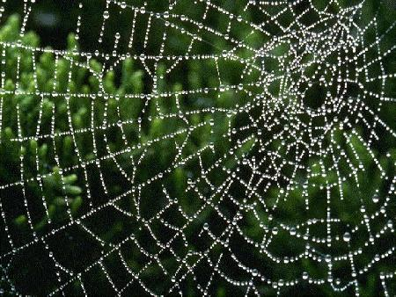
Line
Everywhere you look, you see lines.
In nature you can
see lines in tree
branches:
In a curving river:
Or in a spiders web

Slide 10
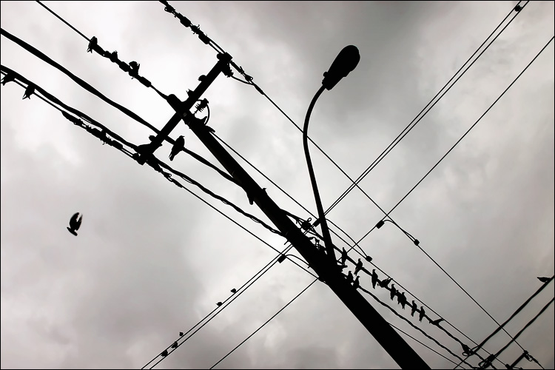
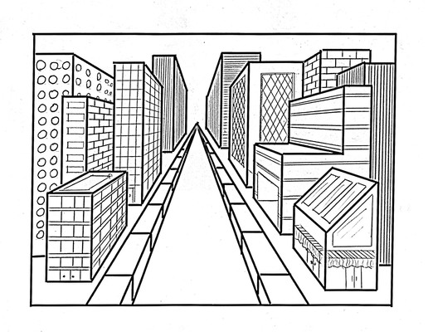

The manufactured world provides examples too
Lines formed by wires: Edges of buildings:
And winding roads

Slide 11
As you have seen, lines can have many qualities:
They can be: curved or straight
Vertical horizontal diagonal
Thick or thin smooth or rough
Light or dark and continuous or broken
In artworks, straight lines generally suggest directness or clarity while curving lines imply gentleness or movement. Vertical lines can give an artwork strength while horizontal lines convey calmness and tranquility. Diagonal lines convey action and energy—think of a lightening bolt or a falling tree. Very thick lines appear strong while a thin line appears weak or delicate. Fuzzy lines imply softness while smooth lines imply harder surfaces. Repeated lines can create patterns, textures and even rhythms.

Slide 12
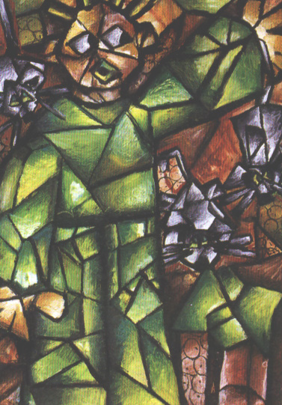
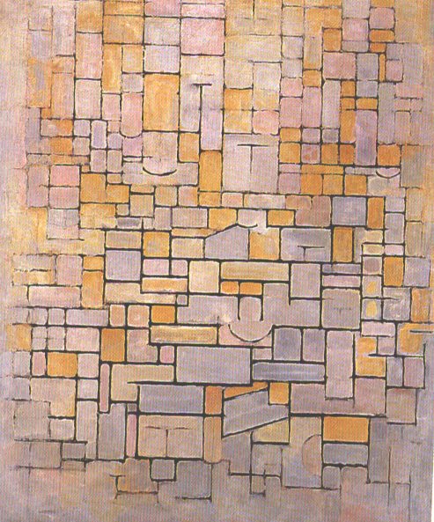
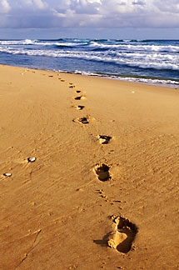
Lines can also be implied or real.
A real line is one you can actually see (Ex. A) while an implied line is the suggestion of a line (Ex. B) An implied line may also be suggested by a string of objects (Ex. C)
(A) (B) (C)

Slide 13
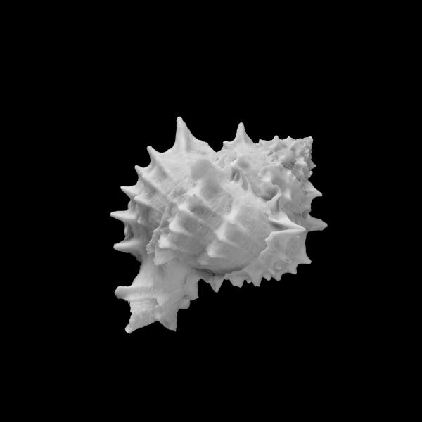
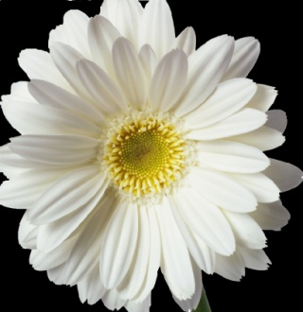

Shape
Shape is a 2-dimensional object (it is flat) It has height and width but no depth. Shapes can be either geometric or organic.
Geometric shapes ---circles, squares and rectangles---are regular and precise. They
can be measured.
Organic shapes are irregular---seashells, leaves, flowers, etc.

Slide 14
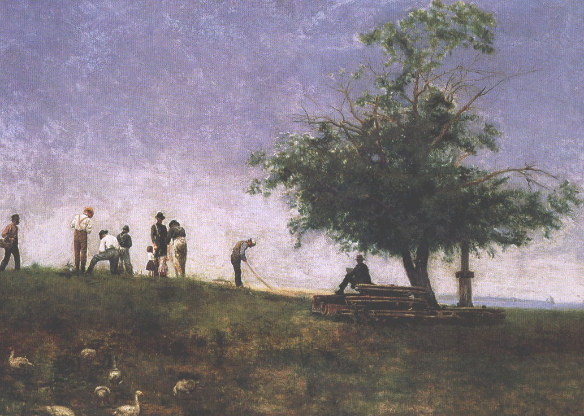
Shape
An artwork is often made up of positive and negative shapes. The positive shapes are usually the solid objects that the artist depicts (see below). The negative shapes are formed by the areas around or between the objects (the sky, grass, mountains, etc)

Slide 15
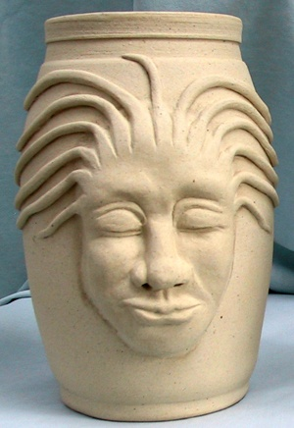
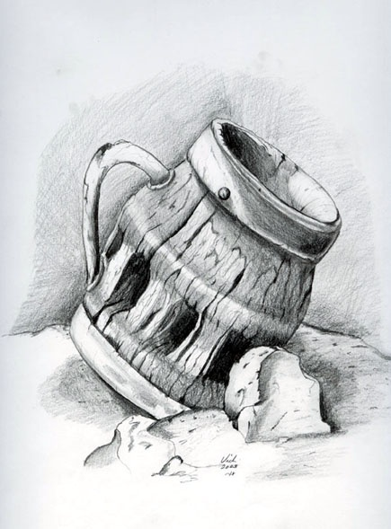
Form
A form is 3-Dimensional. It has height, width AND depth. As with shapes, Forms can be regular and precise or irregular and organic.
3-D art, such as sculptures, architecture and crafts, is composed of forms. In 2-D art, artists can only create the illusion of form.

Slide 16
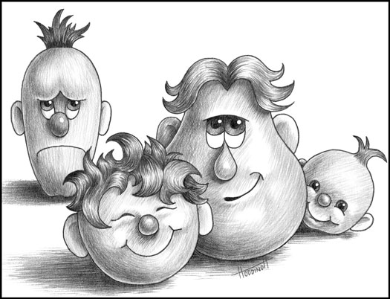
Space
In a 2-D work of art, space is limited to the picture plane. By using color and/or value you can make objects appear to advance (come forward) or recede (go back) into space to create an illusion of depth. Objects with clear surface detail appear nearer to the viewer than fuzzy or plain objects. Also, an illusion of space can be accomplished when objects overlap or are placed higher on the picture plane.
Items farther away appear less detailed or fuzzy
Objects farther away are placed higher on the picture plane
Overlapping gives the illusion of space too.

Slide 17
As you can see in this example of linear perspective, in which parallel lines recede toward a common vanishing point, the illusion of 3-D space is created on a 2-D surface. Objects farther away are higher up on the picture plane, there is overlapping of buildings and less detail as the image seems farther away from the viewer.
Objects farther away are placed higher on the picture plane and are less detailed
e
Buildings are overlapped to create an illusion of space

Slide 18
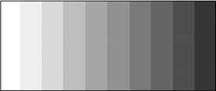
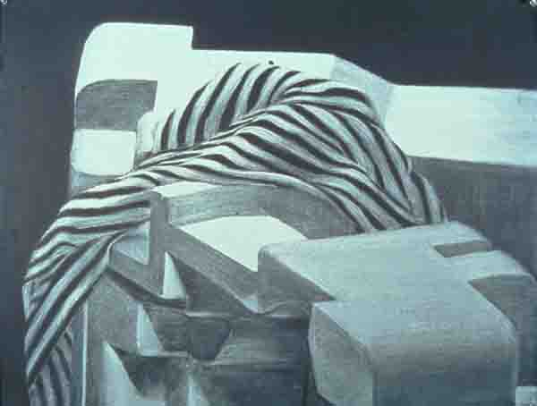
Value
Value refers to the lightness and darkness of a color. Value is commonly known as “shading” of an object.
A value scale, such as this one, can show the full range of a color. This is accomplished by adding black to a color to make shades or adding white to a color to make tints.
TINTS
ORIGINAL COLOR
SHADES
Accomplished artists know, that to make a drawing look as real as possible, they must show a full value range in their artwork

Slide 19
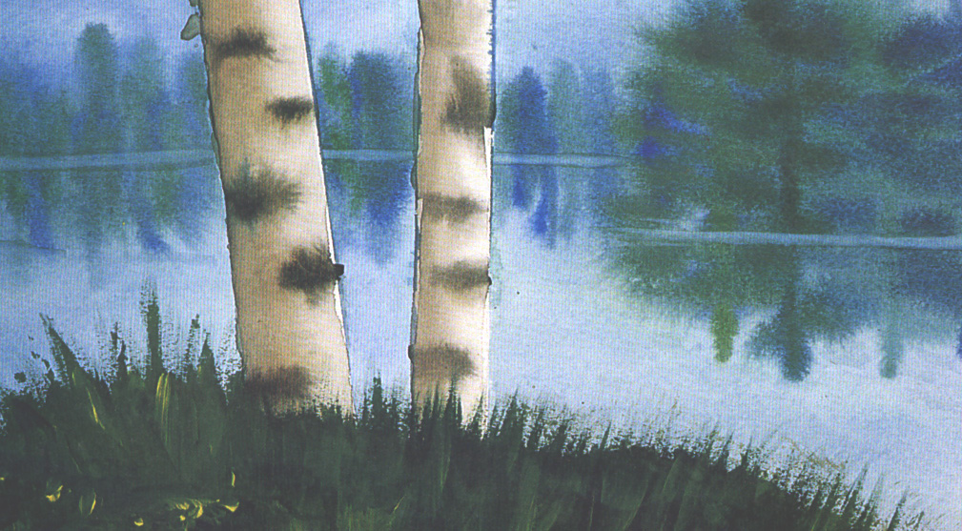
Texture
Texture is the tactile quality of a surface, such as rough, smooth, sticky, fuzzy, soft or slick. Like line, texture can be real or implied. A real texture is one that can be felt, such as a piece of sandpaper, a woven mat, or animal fur. In an artwork, real texture can be created through thickly applied paint, glossy glazes, and gluing objects to the surface. Implied texture is an illusion of texture created by an artist. As you can see below, this artist created a sense of smooth water and prickly grass.

Slide 20
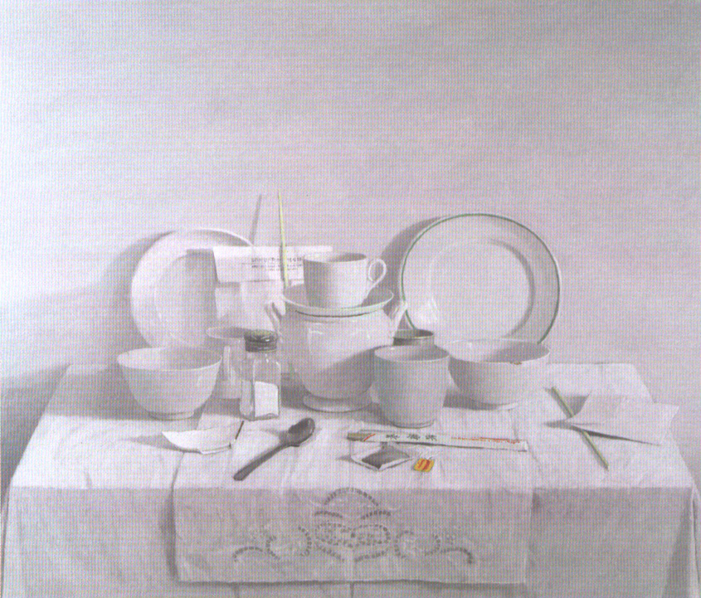
Unity
Unity is a sense of cohesiveness, a feeling that all the parts of something belong or work together. This is an important principle because a unified work looks complete and orderly. There are many ways to create unity in a work of art; a dominant theme or idea, a texture or repeated color, line, shape, etc.
What creates unity in this picture?

Slide 21
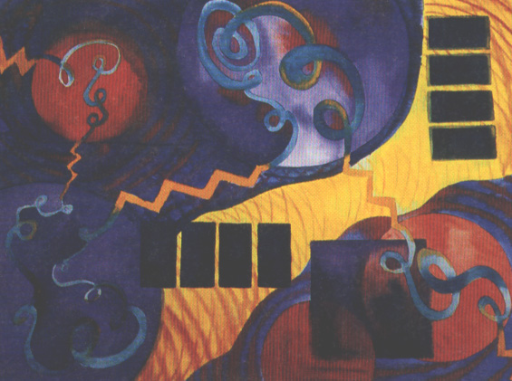
Variety
Variety generally accompanies unity in a work of art; it adds visual interest by giving the eye different things to focus on. Artists create variety by including shapes, textures, lines, etc in many sizes and/or contrasting colors.
How has this artist shown variety? What elements has he used to create it?

Slide 22
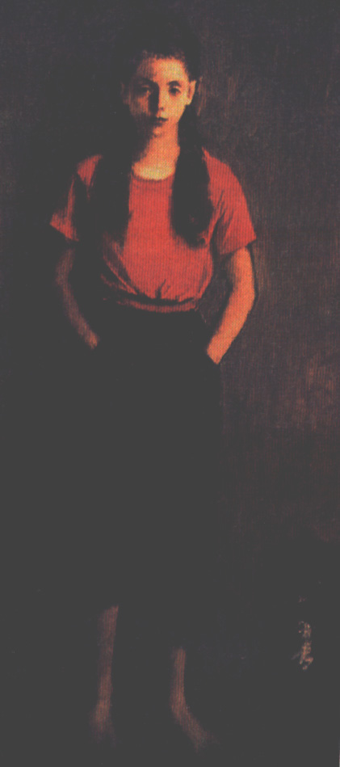
Balance
There are 3 basic kinds of balance;
symmetrical, asymmetrical and radial
Symmetrical balance occurs when one
side of an object or painting is identical
(or nearly so) to the other side. In nature,
the human face and butterflies are examples.
Symmetry can create a sense of calmness
and formality, but sometimes it can be
visually boring.

Slide 23
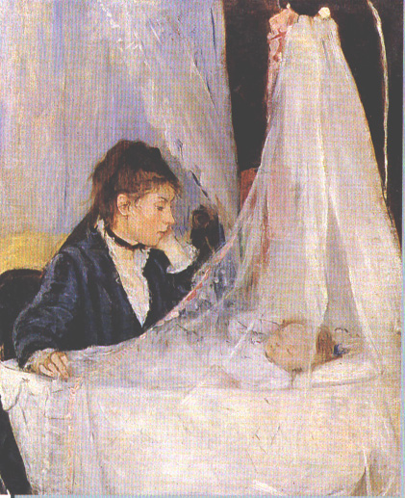
Balance
Asymmetrical balance occurs when the two sides are balanced but different. Small objects near the center may balance out large objects
nearer to the middle or
large areas of light color or
value may balance out small
darker areas.
Asymmetrical balance can
be both subtle and exciting.

Slide 24
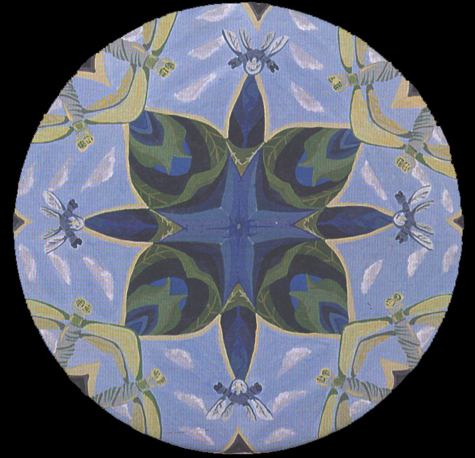
Radial Balance
When a design exhibits
radial balance, its parts
spread out from the
center.
The spokes of a wheel
is an example of radial
balance.
Radial balance is also symmetrical and often produces a graceful rhythm or a sense of turning.

Slide 25
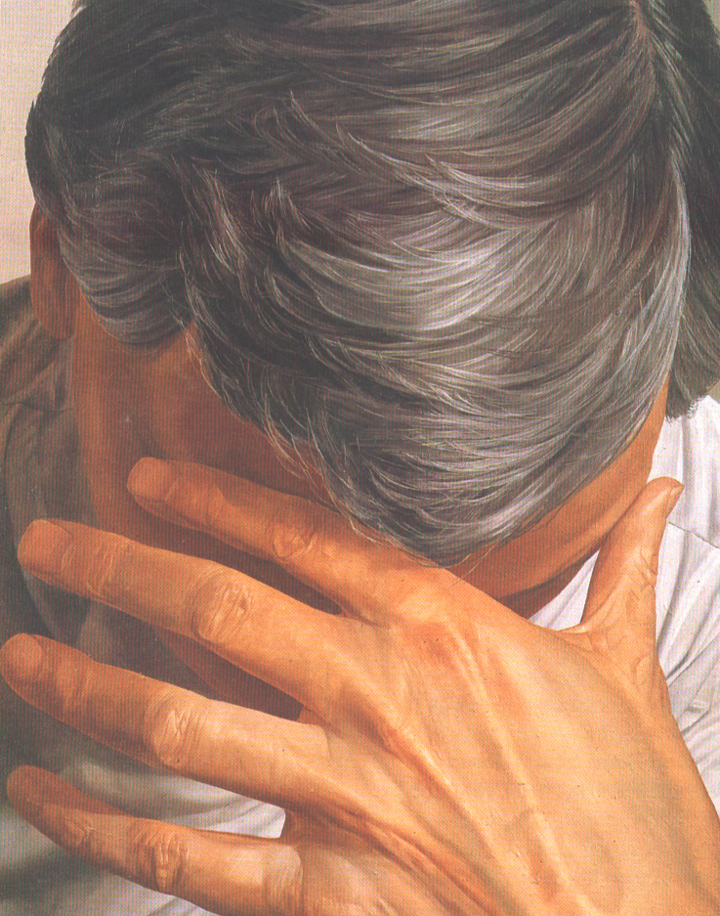
Contrast
The world around you is full
of contrast: a red flower on a
green plant, a smooth pond
surrounded by a rough
shoreline, a fragile spider web
attached to a sturdy fence post.
Contrast creates interest. In an
artwork, a strong contrast of light
and dark will draw a viewer into
a particular place in an artwork.
As will contrasts of rough and
smooth areas, warm and cool
areas, straight and curved lines, or
plain and patterned areas.
What has the artist used as contrasts in
this work of art?

Slide 26
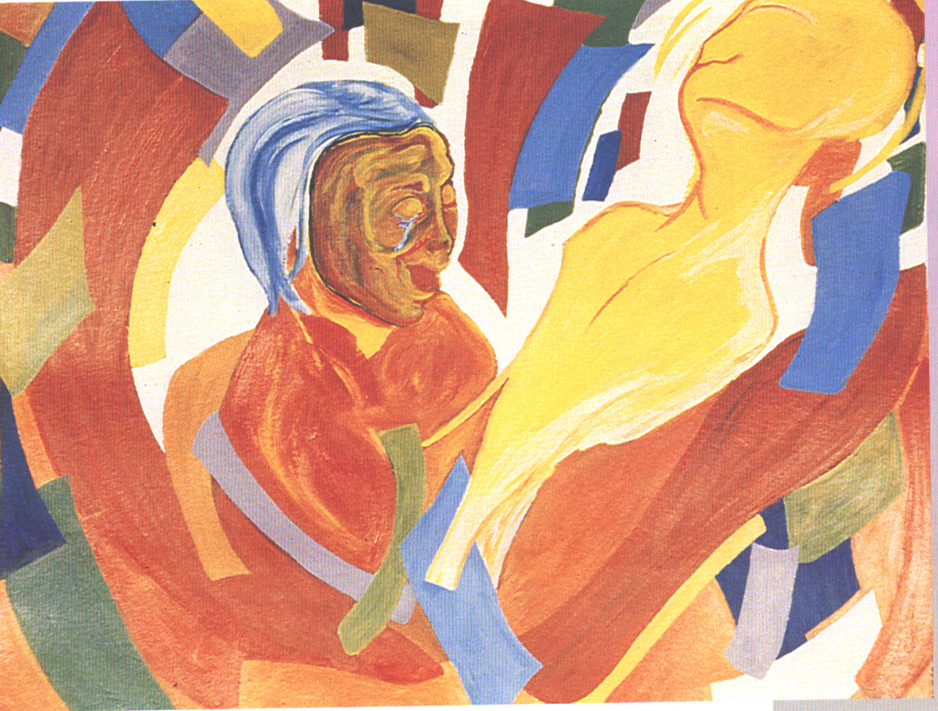
Emphasis
Artists use emphasis to create a center of interest—the part of the work they want the viewer to notice first. Sometimes an artist chooses to emphasize a single element of design to create a center of interest. And sometimes the artist separates the center of interest from its surroundings, makes it the largest object or places it in the center of the composition.
In any work of art, many elements and principles work together, but almost every successful work emphasizes something.
What is the artist trying to get us to notice first in this work of art?

Slide 27
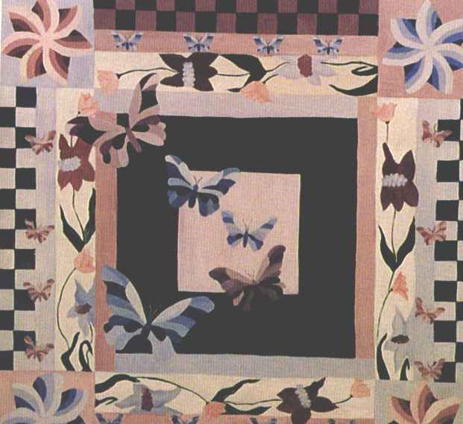
Pattern
Individual units or motifs repeated again and again, create a pattern. In nature, the hexagonal shapes in a honeycomb, stripes of a zebra and the petals of a daisy all form patterns. Patterns can be found in the columns of buildings, a polka-dot tie or the seats of a movie theatre.
In an artwork, artists can
use various patterns to
decorate shapes or to add
texture to the entire
surface. Or he or she
may add a pattern to a
small area to add visual
interest or create contrast.

Slide 28
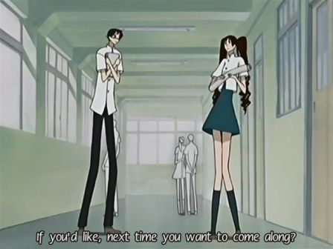
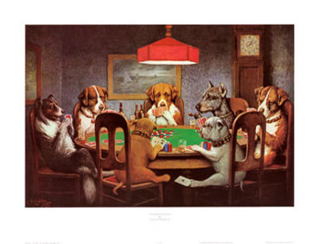
Proportion
Proportion is the relative size of one thing compared to the size of something else. In the paintings below, compare the proportion of the objects in one painting with one another. Do the proportions seem correct?

Slide 29
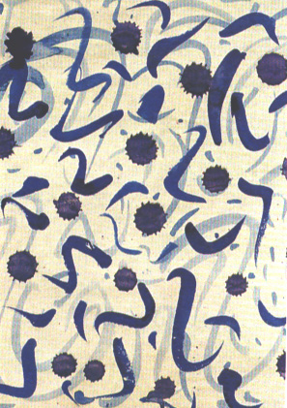
Movement
In a work of art, movement may be the course that a viewer’s eye takes as it moves across the surface. Moving from color to color, shape to shape or value to value, the
eye traces a path around the picture.
Sometimes an artist will add
elements such as spirals, curves,
arrow-like shapes or diagonal
lines to convey a sense of
movement.
How has the artist shown movement
in this picture?

Slide 30
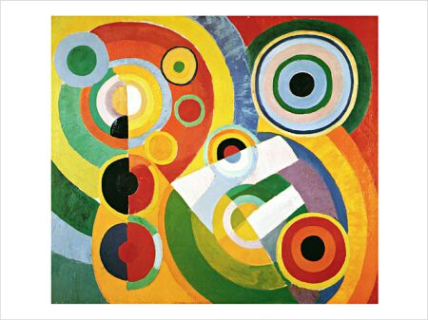
Rhythm
Rhythm is a pattern of movement caused by colors, shapes, values, lines, etc. that occur in organized repetition. If the size, shape or color of the repeated units is the same and if the distance between them remains constant, the rhythm is predictable and may even be monotonous. This is the type of rhythm you could find on wrapping paper or wallpaper.
To add variety and visual excitement, an artist may change the size, color or shape of the repeated units or vary the spacing between them.
How does the artist show an interesting rhythm in this painting?
Is the rhythm exciting or monotonous? How has the artist accomplished this?

